Slide 1

First Deep Learning Program

Slide 2

Architecture

Slide 3
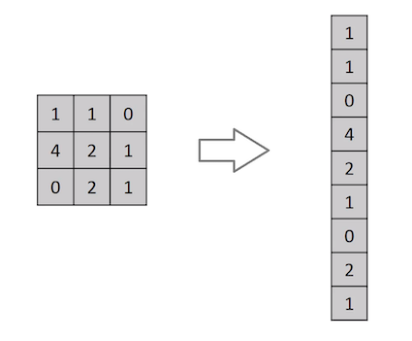
Different from other NN
Do not convert images into vectors or arrays
A ConvNet is able to successfully capture the Spatial and Temporal dependencies in an image through the application of relevant filters.

Slide 4
Convolutional layer
Input image
I = 5x5x1
Kernel K as a 3x3x1 matrix.
Output is 3x3x1

Slide 5
For RGB images

Slide 6
Why more layers for convolution
The objective of the Convolution Operation is to extract the high-level features such as edges, from the input image.
ConvNets need not be limited to only one Convolutional Layer.
Conventionally, the first ConvLayer is responsible for capturing the Low-Level features such as edges, color, gradient orientation, etc. With added layers, the architecture adapts to the High-Level features as well,

Slide 7
Pooling layer
Pooling layer is responsible for reducing the spatial size of the Convolved Feature.
This is to decrease the computational power required to process the data through dimensionality reduction.
Furthermore, it is useful for extracting dominant features

Slide 8
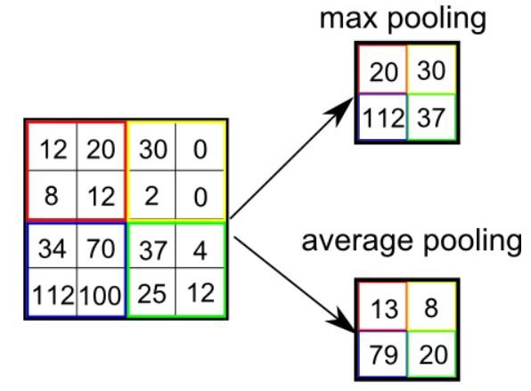
Types of pooling
Max pooling: It returns the maximum value from the portion of the image covered by the Kernel. Max Pooling also performs as a Noise Suppressant
Average Pooling: returns the average of all the values from the portion of the image covered by the Kernel.

Slide 9
Classification
Adding a Fully-Connected layer is a (usually) cheap way of learning non-linear combinations of the high-level features as represented by the output of the convolutional layer.
The Fully-Connected layer is learning a possibly non-linear function in that space.
Over a series of epochs, the model is able to distinguish between dominating and certain low-level features in images and classify them using the Softmax Classification technique.

Slide 10
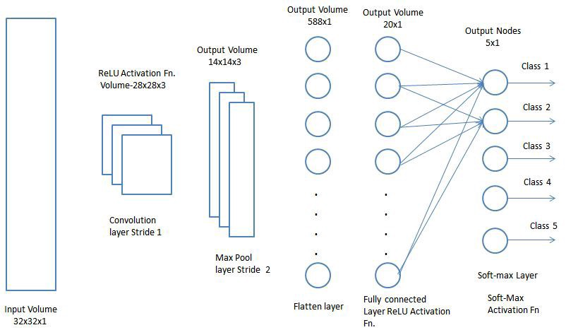

Slide 11
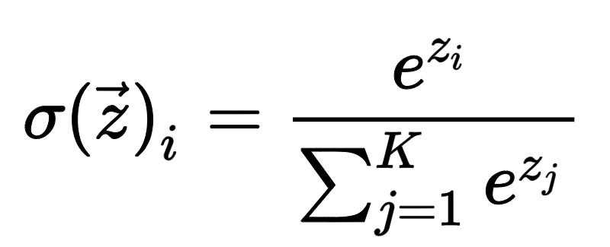
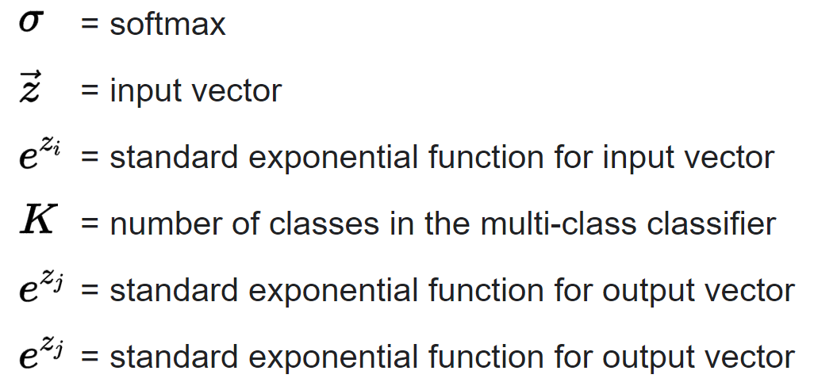
Softmax function

Slide 12
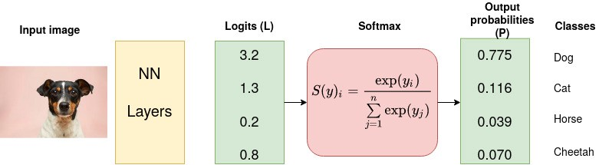
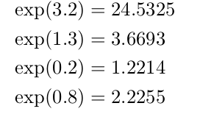
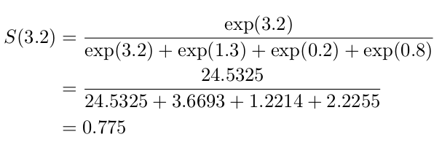
Example

Slide 13
